Slide 1

Geometry
Unit 12, Lesson 4 Solving Problems with Lengths of Two Tangents Volume 2, pg. 246

Slide 2


Benchmark
MA.912.GR.6.1
Solve mathematical and real-world problems involving the length of a secant, tangent, segment, or chord in a given circle.
volume 2, pg. 246

Slide 3
Integrated Mathematical Thinking and Reasoning Standards
MA.K12.MTR.1.1 Actively participate in effortful learning both individually and collectively.
MA.K12.MTR.4.1 Engage in discussions that reflect on the mathematical thinking of self and others.
MA.K12.MTR.5.1 Use patterns and structure to help understand and connect mathematical concepts.
MA.K12.MTR.7.1 Apply mathematics to real-world contexts.
volume 2, pg. 246

Slide 4

Learning Target
I can solve mathematical and real-world problems that involve lengths formed by the intersection of two tangents.
volume 2, pg. 246

Slide 5

Warm-Up
volume 2, pg. 247

Slide 6
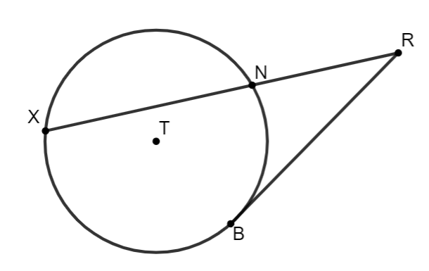
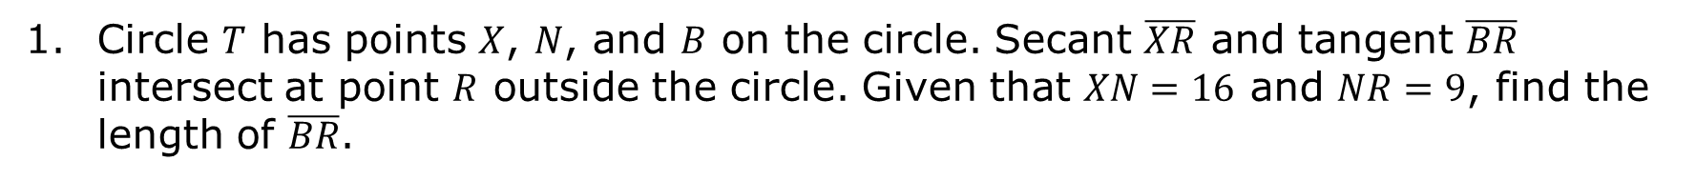
12.4.1 Warm-Up: Bell Work
Circle $T$ has points $X$, $N$, and $B$ on the circle. Secant $\overline{XR}$ and tangent $\overline{BR}$ intersect at point $R$ outside the circle. Given that $XN=16$ and $NR=9$, find the length of $\overline{BR}$.
volume 2, pg. 247

Slide 7

Exploration
volume 2, pg. 247

Slide 8

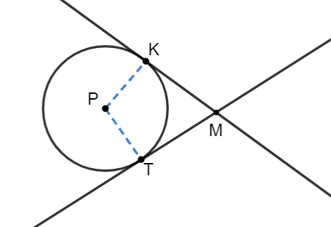
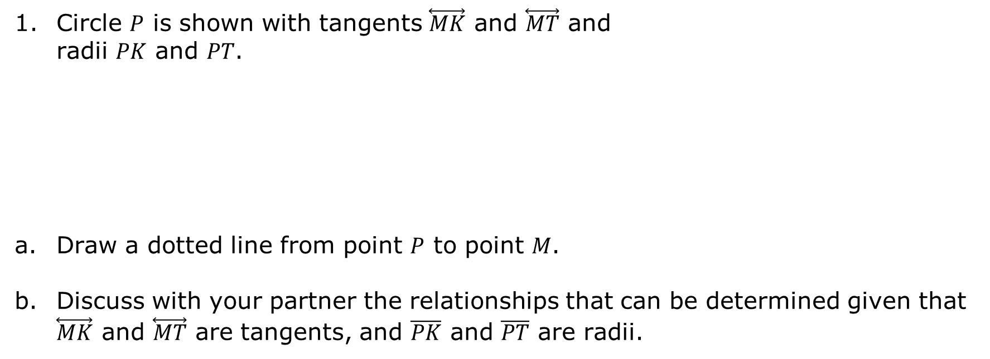
12.4.2 Exploration: Intersecting Tangent Lines
Circle $P$ is shown with tangents $\overset{⃡}{MK}$ and $\overset{⃡}{MT}$ and radii $PK$ and $PT$.
Draw a dotted line from point $P$ to point $M$.
Discuss with your partner the relationships that can be determined given that $\overset{⃡}{MK}$ and $\overset{⃡}{MT}$ are tangents, and $\overline{PK}$ and $\overline{PT}$ are radii.
volume 2, pg. 247

Slide 9

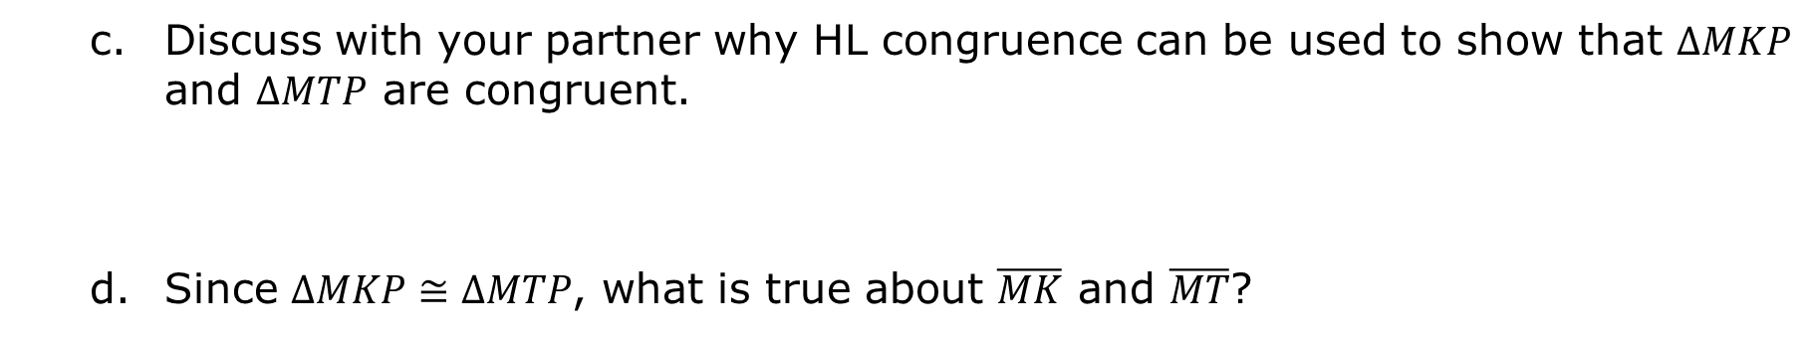
Discuss with your partner why HL congruence can be used to show that $∆MKP$ and $∆MTP$ are congruent.
Since $∆MKP≅∆MTP$, what is true about $\overline{MK}$ and $\overline{MT}$?
Tangent segments to a circle from the same point are congruent.
volume 2, pg. 248

Slide 10

Guided Practice
volume 2, pg. 248

Slide 11

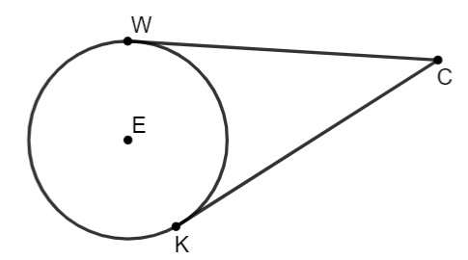
12.4.3 Guided Practice: Solving Problems Involving Intersecting Tangent Lines
Circle $E$ has points $W$ and $K$ on the circle. Tangents $\overline{WC}$ and $\overline{KC}$ intersect at point $C$ outside the circle. If $WC=x+15$ and $KC=2x−5$, find the length of $\overline{KC}$.
volume 2, pg. 248

Slide 12
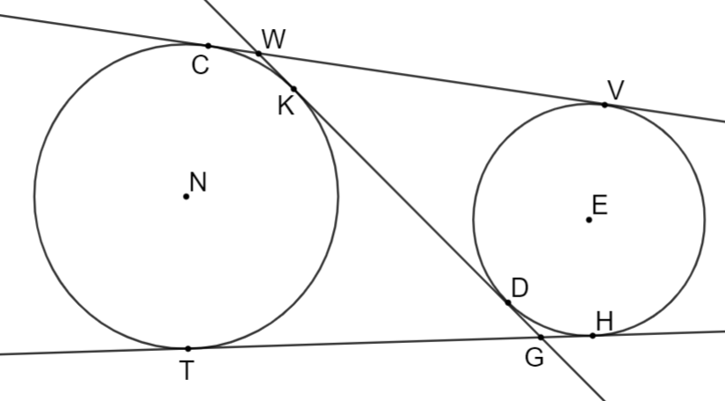
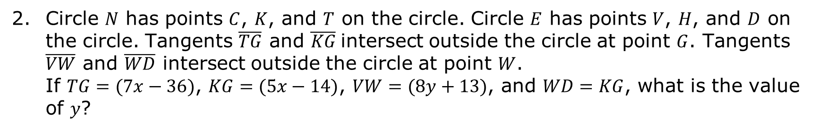
Circle $N$ has points $C$, $K$, and $T$ on the circle. Circle $E$ has points $V$, $H$, and $D$ on the circle. Tangents $\overline{TG}$ and $\overline{KG}$intersect outside the circle at point $G$. Tangents $\overline{VW}$ and $\overline{WD}$ intersect outside the circle at point $W$.
If $TG=(7x−36)$, $KG=(5x−14)$, $VW=(8y+13)$, and $WD=KG$, what is the value of $y$?
volume 2, pg. 249

Slide 13
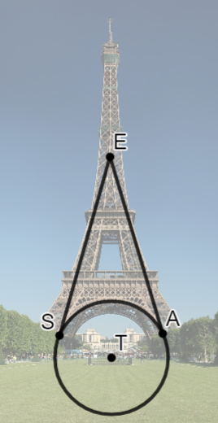
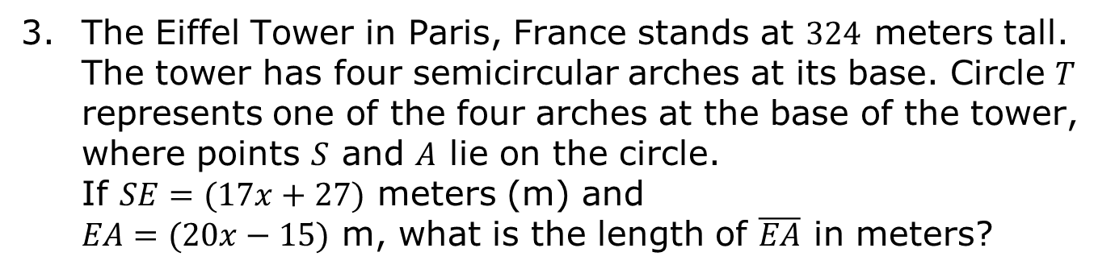
The Eiffel Tower in Paris, France stands at $324$ meters tall. The tower has four semicircular arches at its base. Circle $T$ represents one of the four arches at the base of the tower, where points $S$ and $A$ lie on the circle. If $SE=(17x+27)$ meters (m) and
$EA=(20x−15)$ m, what is the length of $\overline{EA}$ in meters?
volume 2, pg. 249

Slide 14

Your Turn
volume 2, pg. 250

Slide 15
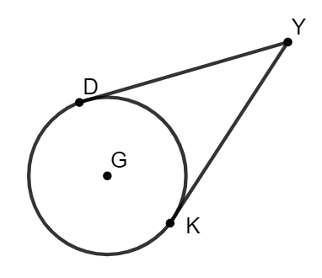
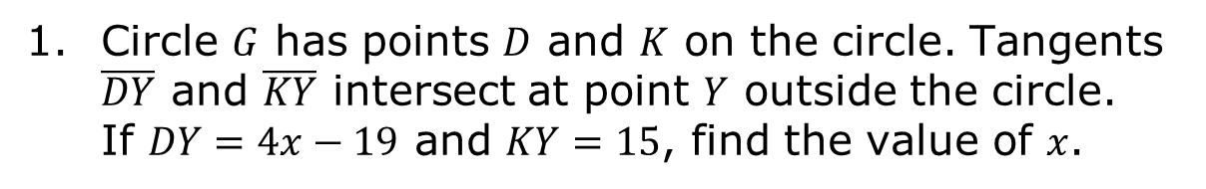
12.4.4 Your Turn!
Circle $G$ has points $D$ and $K$ on the circle. Tangents $\overline{DY}$ and $\overline{KY}$ intersect at point $Y$ outside the circle.
If $DY=4x−19$ and $KY=15$, find the value of $x$.
volume 2, pg. 250

Slide 16
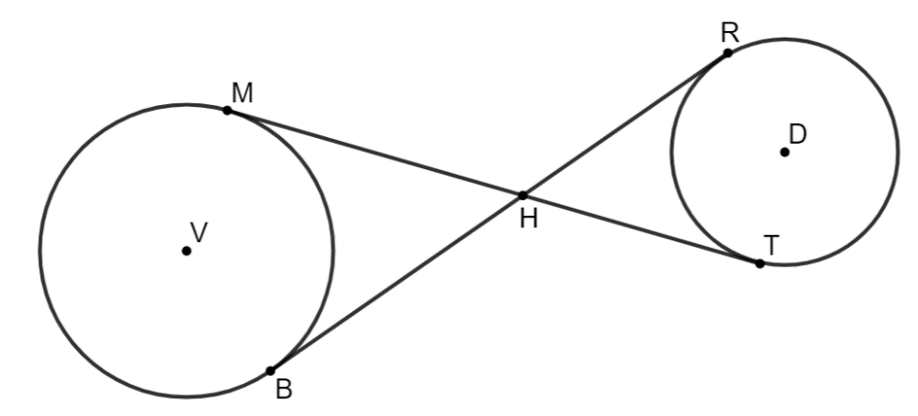
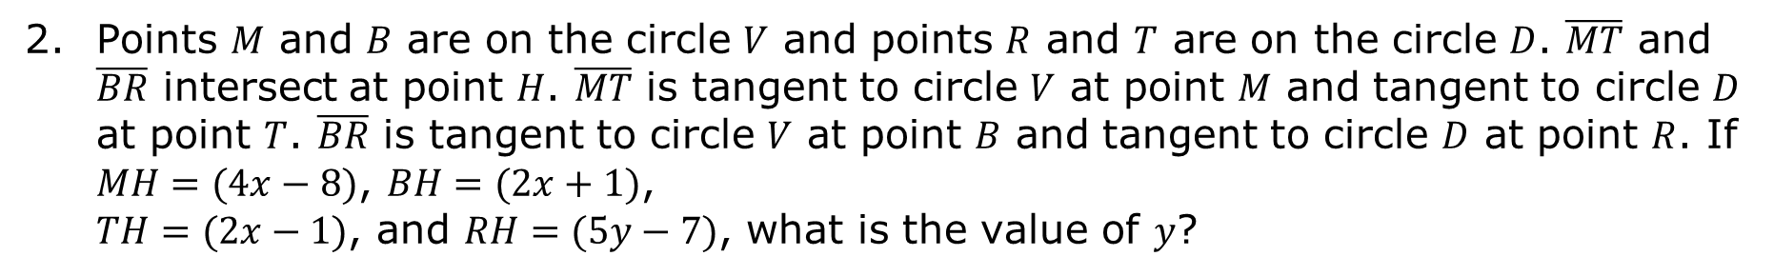
Points $M$ and $B$ are on the circle $V$ and points $R$ and $T$ are on the circle $D$. $\overline{MT}$ and $\overline{BR}$ intersect at point $H$. $\overline{MT}$ is tangent to circle $V$ at point $M$ and tangent to circle $D$ at point $T$. $\overline{BR}$ is tangent to circle $V$ at point $B$ and tangent to circle $D$ at point $R$. If $MH=(4x−8)$, $BH=(2x+1)$, $TH=(2x−1)$, and $RH=(5y−7)$, what is the value of $y$?
volume 2, pg. 250

Slide 17

Wrap-Up
volume 2, pg. 251

Slide 18

12.4.5 Wrap-Up: Cool Down
Write a short note summarizing today’s lesson to a friend who missed class.
volume 2, pg. 251

